Slide 1
Chapter 6
Transactions and Enterprise Resource Planning

Slide 2
Outline
How do you process the data from transactions and integrate the operations of the organization?
How do you efficiently collect transaction data?
What are the major elements and risks of a transaction?
Why are transactions more difficult in an international environment?
How do you track and compare the financial information of a firm?
What are the transaction elements in the human resources management system?
Can a company become more efficient and productive?
How do businesses combine data from operations?
How do you combine data across functional areas, including production, purchasing, marketing, and accounting?
How do you make production more efficient?
How do you keep track of all customer interactions? Who are your best customers?
How can a manager handle all of the data in an ERP system?
How does the CEO know that financial records are correct?

Slide 3
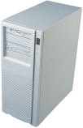


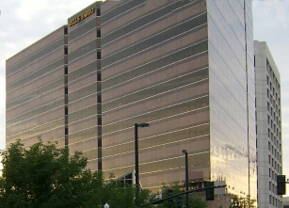


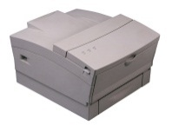
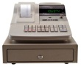

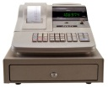

Transactions and Integration
Additional
Stores
CEO Information
Strategy
Bank
Tactics
Warehouse
Inventory
Management
Operations
Supplier
EDI
POS
Sales Reports
Cash
Registers
Customers
Process Control
Central Computer

Slide 4



Data Capture
Banking and Finance
Sales
Workers
Process Control
Collecting transaction data at the point of sale ensures accurate data, speeds transactions, and provides up-to-the-minute data to managers.

Slide 5
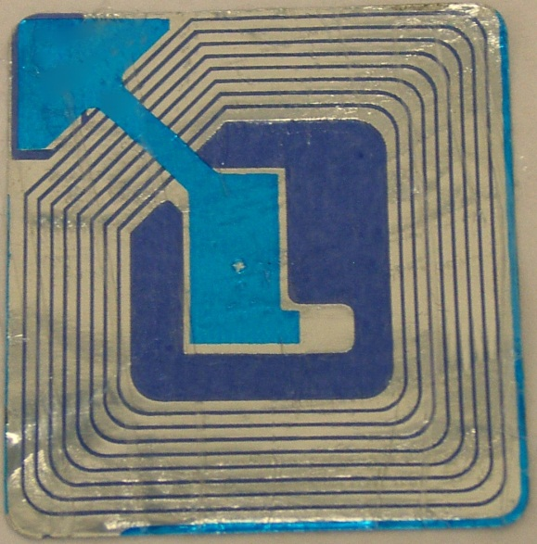
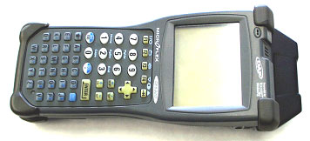
Radio Frequency Identification (RFID)
Radio/microwaves
RFID tag
Simple security tag
Capacitor: collected energy
C
B
E
antenna
Transistors: data
RFID reader
Data:
Alter the waves
Scanner from: http://www.rfidinc.com

Slide 6

QR Codes
Two-dimensional code.
Can hold thousands of characters or digits.
Can be read by cell phone cameras.
Initially used for packages.
Now, often used for marketing, even billboards, museum and art pieces, and bus schedules.
http://qrcode.kaywa.com/
One of several Web sites to create free QR codes.

Slide 7
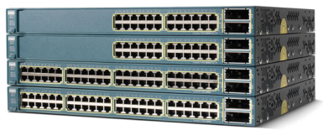
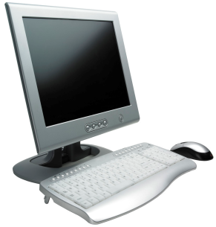
Process Control
Various Production machines: lathe, press, dryer, . ..
Production data:
Quantity
Quality
Time
Machine status
Control Terminal
Control settings
and commands

Slide 8
Electronic Data Interchange
The price of paper
$30 to $40 for each purchase order
$24 to $28 for suppliers to handle
EDI
$12 for orders
0.32 for suppliers
Proprietary EDI
Commercial providers and standards

Slide 9



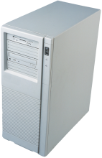
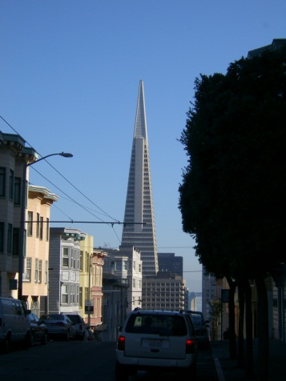

EDI: Proprietary
Firms must support multiple data formats and sometimes different computers for each contact.
Order
Database
& Accounts
Supplier
Queries &
Orders
Customer 1
Production
Database
& Accounts
Invoices &
confirmation
Convert
Convert
Customer 2

Slide 10

EDI: Standards
Bank/EDI consolidator
Route
Messages
Convert to
Standard
Customer 1
Order
Database
& Accounts
Messages
to/from
any customer
Convert to
Standard
Production
Database
& Accounts
Convert to
Standard
Customer 2
Supplier

Slide 11
EDI Standards
UN Edifact
US ANSI X12
Segments for each area
Detail data formats
Message
Segment
Composite Data Element
Data Element
Code Lists

Slide 12
ANSI X12 Segments
Partial List of segments
Detailed specifications for each segment
Data needed
Format
104 - Air Shipment Information
110 - Air Freight Details and Invoice
125 - Multilevel Railcar Load Details
126 - Vehicle Application Advice
127 - Vehicle Buying Order
128 - Dealer Information
129 - Vehicle Carrier Rate Update
130 - Student Educational Record (Transcript)
131 - Student Educational Record (Transcript) Acknowledgment
135 - Student Loan Application
139 - Student Loan Guarantee Result
140 - Product Registration
141 - Product Service Claim Response
142 - Product Service Claim
143 - Product Service Notification
144 - Student Loan Transfer and Status Verification
146 - Request for Student Educational Record (Transcript)
147 - Response to Request for Student Ed. Record (Transcript)
148 - Report of Injury or Illness

Slide 13


EDI On The Internet
Advantages
Low cost.
Anyone can connect.
Worldwide reach.
Many tools and standards.
The Internet
Edifact Message

Slide 14
Extensible Markup Language (XML)
<?xml version="1.0"?>
<!DOCTYPE OrderList SYSTEM "orderlist.dtd">
<OrderList>
<Order>
<OrderID>1</OrderID>
<OrderDate>3/6/2004</OrderDate>
<ShippingCost>$33.54</ShippingCost>
<Comment>Need immediately.</Comment>
<Items>
<ItemID>30</ItemID>
<Description>Flea Collar-Dog-Medium</Description>
<Quantity>208</Quantity>
<Cost>$4.42</Cost>
<ItemID>27</ItemID>
<Description>Aquarium Filter &amp; Pump</Description>
<Quantity>8</Quantity>
<Cost>$24.65</Cost>
</Items>
</Order>
</OrderList>
Example
Data is sent in a standard format that is easy for computers to parse and read.

Slide 15
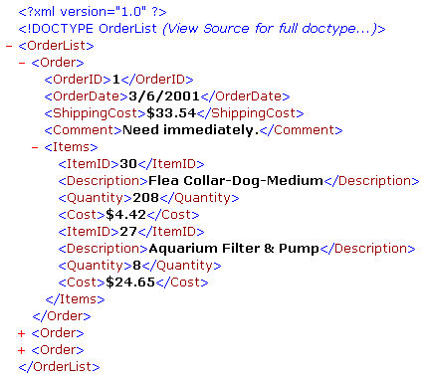
XML: eXtensible Markup Language
Used as a standard means to transfer data to machines with unknown capabilities.
Most hardware and software can read and understand the data.
The tags describe the content.
Usually a separate schema file is used to describe the tags and the document structure.

Slide 16
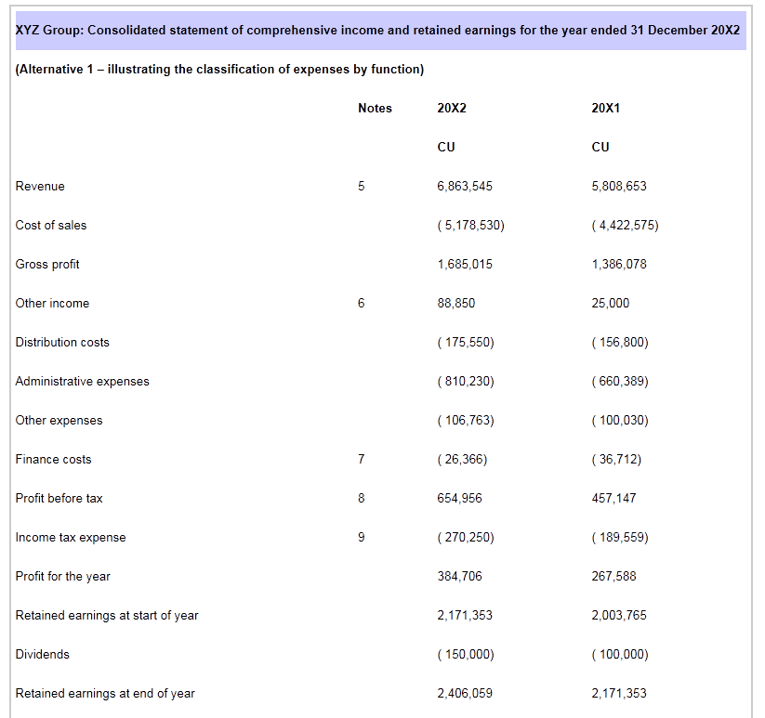
Extensible Business Reporting Language: XBRL
http://media.ifrs.org/ixbrl_example1_2011-03-25.xhtml

Slide 17
XBRL Sample tag: Revenue
<ix:nonFraction
contextRef="y2012“
format="ixt:numcommadot" name="ifrs:Revenue"
unitRef="EUR" decimals="0" scale="0"
id="XWAND00000326">6,863,545
</ix:nonFraction>
Attributes
Data
The Securities and Exchange Commission is requiring XBRL filings as of June 2011. The goal is to standardize reporting data and make it accessible to automated systems.

Slide 18
Transaction Objects
Example Attributes
Date & time
Price
Quantity
Item Number
Buyer
Seller
Example Methods
Store
Print
Verify
Transactions
Items
Date & Time
Value
Item
Buyer
Seller
Item_Id
Description
Location
. . .
Buyers
Buyer_Id
Address
Phone
Sellers
Seller_Id
Address
Phone

Slide 19



Transaction Risks
Credit card company accepts risks for a fee.
Vendor
1. Receive payment.
2. Legitimate payment.
3. Customer not repudiate sale.
4. Government not invalidate sale.
payment
products or services
Government
Customer
1. Transaction record.
2. Tax records.
3. Identify fraud.
4. Track money for other cases (drugs).
1. Receive product.
2. Charged only as agreed.
3. Seller not repudiate sale.
4. Legal transaction.

Slide 20
Security and Trust
Security
Each transmission is encrypted.
Prevent interception.
Keys generated by certificate authority (e.g., Verisign).
Security on individual servers is the responsibility of vendor.
There have been some thefts of data (e.g., credit-card numbers.)
Vendor is motivated to secure the server.
Commercial software exists to provide secure sites.
Trust
Is the vendor legitimate?
Consider: Internet gambling.
What if offshore vendor refuses to pay off a bet?
As long as Internet gambling is illegal (in the U.S.) consumer has no recourse.
Otherwise, use credit cards and rely on banks.
Secure certificates.
Is the customer legitimate?
Rely on credit card data.
Some vendors will ship only to billing address.
Certificate authority.

Slide 21

International Transaction Issues
Shipping
Currencies
Languages
Customs and tariffs
Jurisdiction for disputes
Different laws and systems
Verify seller and purchaser
Payment methods
http://worldwind.arc.nasa.gov

Slide 22
Accounting
Financial data and reports
What do things really cost?
The accounting cycle
Inventory
Checks and balances
Double-entry
Separation of duties
Audit trails

Slide 23
Accounting
Management
Banks
and
Creditors
Loans & Notes
Planning Reports
Shareholders
Cash
Management,
Investments,
Foreign
Exchange
Management
Reports
Strategic
& Tactical
Planning
Shareholder
Reports
Capital Acct
Produce
Shareholder
Reports
Governments
Departments
& Employees
Planning
Data
Payroll &
Employee
Benefits
Produce
Management
Accounting
Reports
Equity
Tax Filings
Expenses
Tax
Filing &
Planning
Tax data
Payroll
Receivables
Inventory &
Assets
Sales Tax
Orders &
Accounts
Payable
Sales &
Accounts
Receivable
Payables
Inventory
Management,
& Fixed Asset
& Cost Acct.
Sales & Receivables
Customers
Purchases &
Payables
Inventory Changes
Inventory Changes
Suppliers
Supply &
In-process
Inventory
Product
Inventory

Slide 24
Accounting Software
General Ledger
Sample chart of accounts
Automatic posting
Automatic entry of vendors
Fiscal years
Keep past data books open
Post to prior years
Allocate department expenses
Accounts Receivable
Automatic early discounts
Interest on late payments
Multiple shipping addresses
Sales tax
Automatic reminder notices
Automatic monthly fees
Keep monthly details
Accounts payable
Check reconciliation
Automatic recurring entries
Monitor payment discounts
Select bills from screen
Pay by item, not just total bill
General Features
Printer support
Use of preprinted forms
Custom reports
Custom queries
Security controls
Technical support costs

Slide 25
The Role of Accounting
Transaction Data
Journal entries—double entry: money and categories
General ledger—summary data by categories
Information is defined by the chart of accounts
Purchases, Sales, Loans, and Investments
Inventory Control
Process and Controls
Double-Entry Systems
Separation of Duties
Audit Trails
Exception reports

Slide 26
Human Resources Management
Management
Compile
Merit
Evaluations
& Salary
Changes
Management Reports
Managers
Merit
Evaluations
Produce
Management
Employee
Reports
Government
Produce
Government
Reports
Merit &
Salary
Salary
Employee
Summaries
Government
Reports
EEO Data
Process
Payroll
Benefits
Vacation
Employee
Data
Employee Data Files
Screen
Jobs &
Applications
Employee
Data
Job &
Applicant
Data
Applicant Data
Sales Data &
Commission
Employees
Customers
Job
Applicants

Slide 27



Production Management
Suppliers
Receiving
Bill of Materials
Crank UL6500
Pedals LK3500
Stem UL6600
Saddle Selle
…
Quality
Purchase Orders
Production and Assembly
Production
Information
System
Quality
Customers
Quality
Shipping
Customer Order

Slide 28
Production Management Issues
factories
Multiple factories produce many items that need to be distributed to multiple stores.
Ask Gitano Jeans in the 1980s
How do you schedule efficient production?
How do you ensure the right products go to the right locations?
Customers or stores

Slide 29
Distribution Center
Factories
Split the mass production shipments into smaller units and distribute to stores immediately—without holding inventory.
Customer or stores
Need to match orders exactly, and carefully schedule arrival time of shipments.

Slide 30
Integrated Report Example

Slide 31
1960s & 1970s MIS Pieces
Accounting:
Integrated Data
Separate
Reports
Marketing:
Forecasts
Production:
MRP
Purchasing:
Orders
Sales:
Orders

Slide 32
Changes
Sales
Terminals
1970s
Management
sales
Central
computer:
create reports
3 reports
Manager:
Integrate, graph
analyze
(printed)
weekly reports
data
Sales
Terminals
Secretary:
type & revise
Sales
Terminals
1980s
Management
sales
Central
computer:
create reports
3 reports
Manager:
Integrate, graph
analyze
(printed)
weekly reports
data
Sales
Terminals
personal computer
Sales
Terminals
1990s
Management
query
Personal Computer
Weekly reports &
ad hoc queries
(applications)
sales
DBMS:
On-line data
data
Sales
Terminals
data

Slide 33
Integration in 2000s
Management
Sales
Terminals
query
Executive Information
System
Personal Computer
Or PDA
Or Browser
sales
DBMS
data
Sales
Terminals
data
Suppliers
Production/
Service
Enterprise Resource Planning
Banks

Slide 34
ERP Integration
Headquarters
(England)
Subsidiary
(Spain)
Database
Use inventory item.
Deduct quantity.
Update inventory value.
Check for reorder point.
Order new item through EDI.
Update Accounts payable.
Database
Financial data
General ledger
Payroll
…
Manufacturing
Product details
Inventory
…
Weekly financial status.
Cash flow.
Budget versus actual cost.
Project cost report.
Daily production report.

Slide 35
ERP Primary Functions
Accounting
All transaction data and all financial statements in any currency
Finance
Portfolio management and financial projections
Human Resources Management
Employee tracking from application to release
Production Management
Product design and manufacturing lifecycle
Logistics/Supply Chain Management
Purchasing, quality control, tracking
Customer Relationship Management
Contacts, orders, shipments

Slide 36
Enterprise Resource Planning
Integrated systems
Examples
SAP
PeopleSoft
Oracle Financials
Basic features included
Accounting
Purchasing
HRM
Investment management
International environment
Multiple currencies
Multiple languages
Procedures and practices
Follows local (national) rules
Follows consolidation rules
Example
U.S. firm with European subsidiaries.
Data is entered once
European reports are generated for subsidiaries following local rules
Results are converted and consolidated to U.S. firm following international and U.S. rules

Slide 37
SAP
Based in Germany, now worldwide
Support for international transactions and multinational firms
Runs on multiple database and hardware platforms
Can handle large and small companies
Expensive, but price is relative.
Financials
Logistics
Human resource management

Slide 38
SAP Financials
Financial Accounting
General ledger
Accounts receivable/payable
Special ledgers
Fixed assets
Legal consolidation
Investment Management
Investment planning/budgeting/control
Depreciation forecast/simulation/calculate
Controls
Overhead cost
Activity based costing
Product cost
Profitability analysis
Treasury
Cash management
Treasury management
Market risk management
Funds management
Enterprise Control
Executive information system
Business planning and budgeting
Profit center accounting
Consolidation

Slide 39
SAP Logistics
Purchasing
Materials management
Manufacturing
Warehousing
Quality management
Plant maintenance
Service management
Sales
Distribution
Product data management
Master data management
Design and change process
Product structure
Development projects
Sales and distribution
Sales activities
Sales order management
Shipping and transportation
Billing
Sales information system

Slide 40
SAP Logistics
Production planning and control
Production planning
Material requirements planning
Production control and capacity planning
Costing
Order information system
Shop floor information system
Project system
Work breakdown structures
Network planning techniques, milestones
Cost, revenue, financial, schedule, and resource management
Earned value calculation
Project information system

Slide 41
SAP Logistics
Materials management
Purchasing
Inventory management
Warehouse management
Invoice verification
Inventory controlling
Purchasing information system
Quality management
Quality planning
Quality inspections
Quality control
Quality notifications and certificates
Quality management information system
Plant maintenance
Structuring technical systems
Maintenance resource planning
Maintenance planning
System for technical and cost accounting data
Maintenance information system

Slide 42
SAP Logistics
Service management
Customer installed base administration
Service contract management
Call management
Billing
Service information system
Integration
When the clerk enters a sale, bills are generated automatically (mail, fax, or EDI).
Sales and revenue are instantly updated in financial and control modules.
The sales information system and EIS provide various up-to-date views and reports.

Slide 43
SAP HRM
Personnel management
HR master data
Personnel administration
Information systems
Recruitment
Travel management
Benefits administration
Salary administration
Organizational management
Organization structure
Staffing schedules
Job descriptions
Planning scenarios
Personnel cost planning
Payroll accounting
Gross/net accounting
History function
Dialog capability
Multi-currency capability
International solutions
Time management
Shift planning
Work schedules
Time recording
Absence determination
Error handling

Slide 44
SAP HRM
Personnel development
Career and succession planning
Profile comparisons
Qualifications assessments
Additional training determination
Training and event management
Other features
SAP Business workflow
Internet scenarios
Employee self-service

Slide 45
SAP Integration
Financial general ledger holds all base totals.
Sub-ledgers are defined for important accounts
Accounts payable
Manufacturing
User-defined
etc.
All transactions automatically flow through
Including currency conversions
Special rules can be defined
Simple example
Manufacturing uses an item from inventory
The quantity on hand is updated
The inventory value is automatically changed
On any sub-ledgers
On the general ledger
Reports are generated in any currency
New orders and payments can be generated through EFT.

Slide 46
Supply Chain Management
Design feasibility
& production costs
Design &
Engineering
Designs and Quality
Marketing
product planning
Quality control
& Custom orders
planning
& monitoring
Manufacturing
planning
& monitoring
Vendors
Customers
Purchasing
Distribution
Demand-pull
Mass
Customization
Quick
Response
Just-in-Time
partnerships
& joint
development
Administration & Management
partnerships
& joint
development
HRM
Accounting
Finance
MIS

Slide 47


Purchasing/Logistics
Buyer
Suppliers
Identify product features Request for Proposal Evaluate suppliers Negotiate contract Identify exact items and costs Correct errors Receive products Match receipts against order Return items Pay supplier | Provide product details Negotiate contracts Verify orders and times Correct errors Schedule delivery Monitor shipments Handle returns Monitor payments

Slide 48
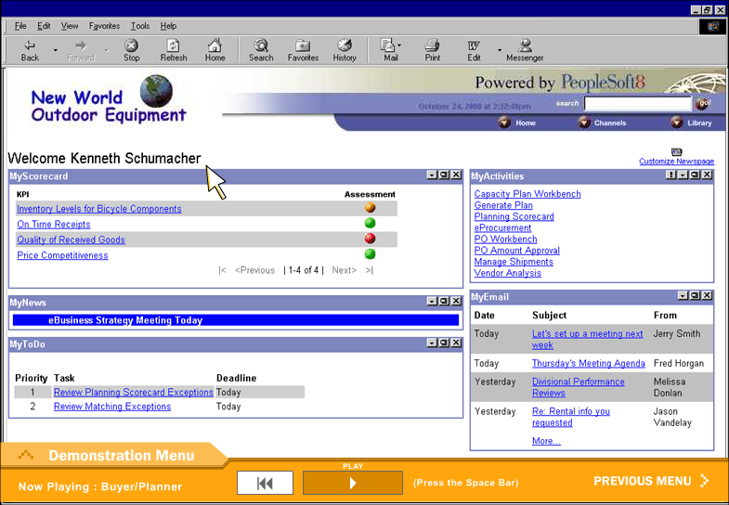
PeopleSoft SCM: Buyer/Planner

Slide 49
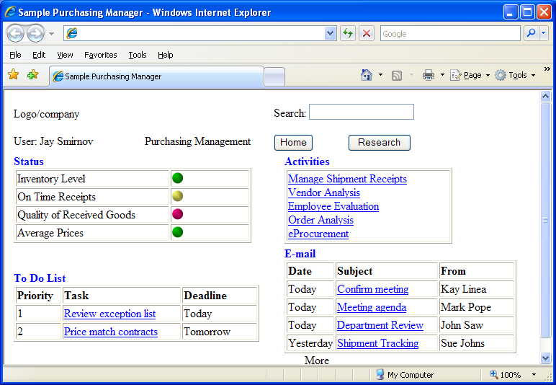
Supply Chain: Purchasing

Slide 50


The Role of XML
Buyer
Supplier
Messages and data
<xml>
<order>
…
</order>
</xml>
ERP: Oracle
ERP: SAP

Slide 51
Customer Relationship Management
Multiple Contact Points
The goal is to provide a single, integrated view of all customer activity, available to all employees who interact with the customer.
Feedback, Individual Needs, and Cross Selling
Having better information enables workers to provide better service, meet the individual needs of each customer.

Slide 52
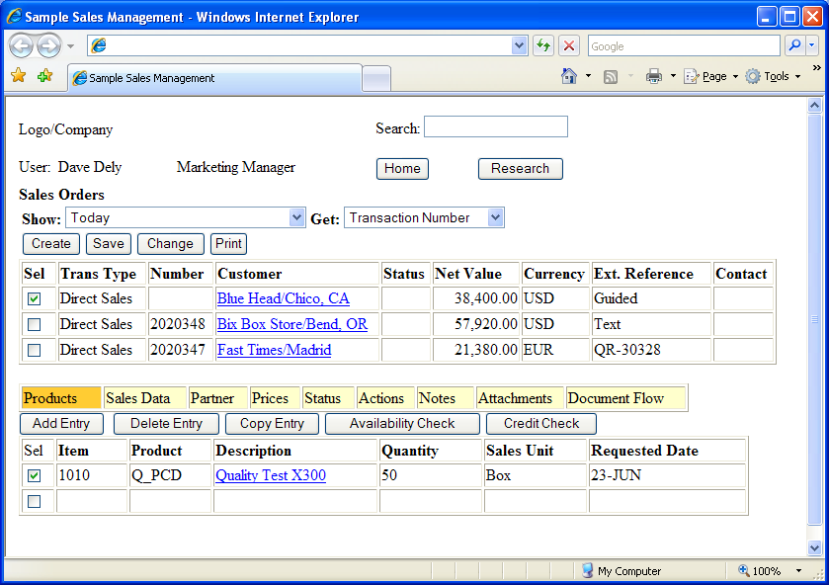
CRM: Sales Management

Slide 53
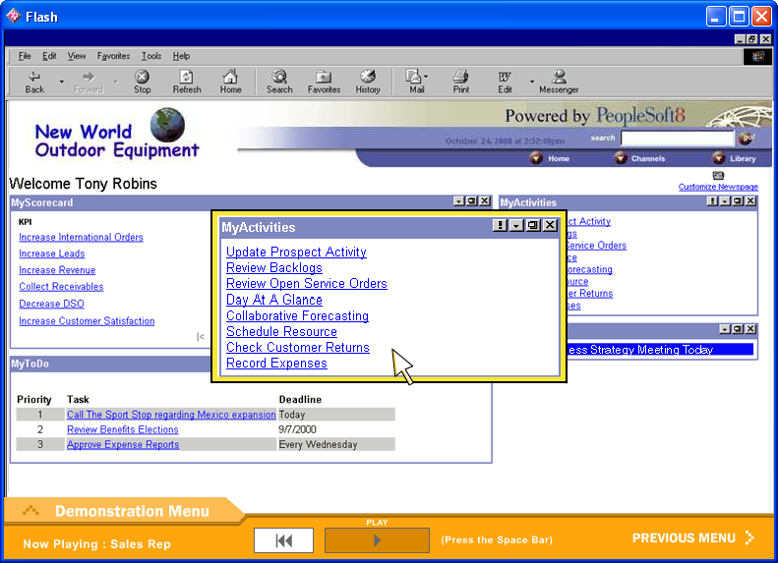
PeopleSoft CRM: Salesperson Perspective

Slide 54
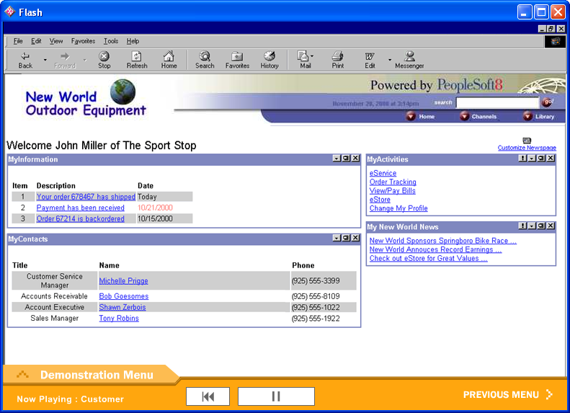
PeopleSoft CRM: Customer Perspective

Slide 55
ERP: Summarizing Data
An ERP database can be gigantic.
It would take time to evaluate every single transaction.
Managers, particularly executives, need to begin with a summary of some basic conditions.
The summary is usually graphical.
Managers can then drill down and look at the detail.

Slide 56
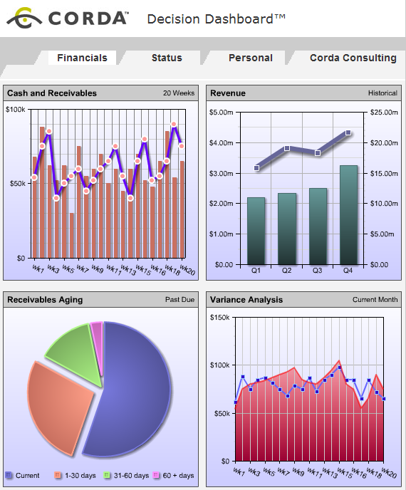
Digital Dashboard Example
Charts
Gauges
Icons
Tickers
Exceptions
Drill-down links
http://www.corda.com/examples/go/ddash/front.cfm

Slide 57
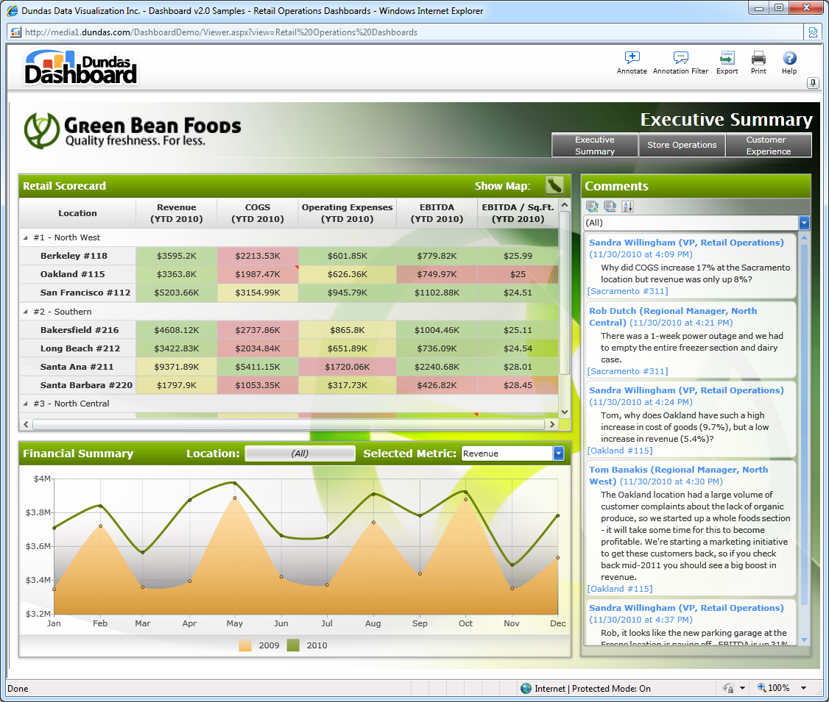
Digital Dashboard Examples
http://www.dundas.com/dashboard/start/samples/?Campaign=GoogleDashboardExamples&gclid=CKme4q6du6cCFQE2gwodCAz8Bg
Active, Silverlight examples from Dundas

Slide 58
Executive IS: Drill-Down
Sales
Production Costs
Distribution Costs
Fixed Costs
Production Costs
South
North
Overseas
Executives
Data for EIS
Central Management
Production: North
Item# 1995 1994
1234 542.1 442.3
2938 631.3 153.5
7319 753.1 623.8
Data
Data
Sales
Data
Production
Distribution
Data

Slide 59

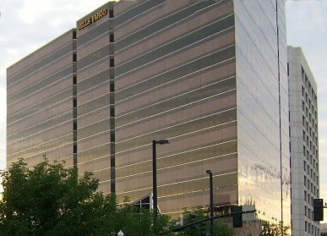

Audits and Sarbanes-Oxley
Financial
Statements
Cash
Inventory
Sales
Inventory
Some financial numbers are tied to the outside world.
Validate these to anchor the statements.
Bank
Customer

Slide 60
Cloud Computing and ERP
Several companies provide online services
NetSuite.com
Lawson, Oracle, and SAP provide some hosting options
Many others
Few companies use accounting systems in the cloud.
Security, privacy, and reliability concerns
Customization is needed in both cases and it can be expensive
Variable costs can be expensive over time
Browser-based approach is relatively new and mobile networking has been expensive and slow
CRM is popular online
Largely Salesforce.com
But if it is not integrated with the ERP it is largely contact management.

Slide 61
Technology Toolbox: Selecting an ERP System
Planning Stage | Goals and Outputs
Initiation | Estimate costs, establish objectives, select team
Initial Planning | Initial vendor list and basic features (hardware platform, fees, internationalization, vendor size and stability, industry-specific support and so on.)
Requirements Gathering | Identify business requirements. Detailed list of specifications, unit goals, and critical features. Evaluation criteria.
Demos and Selection | Product demonstrations, ratings, and site visits.
Implementation | Customize applications, convert data, restructure company operations, define new processes and train employees.

Slide 62
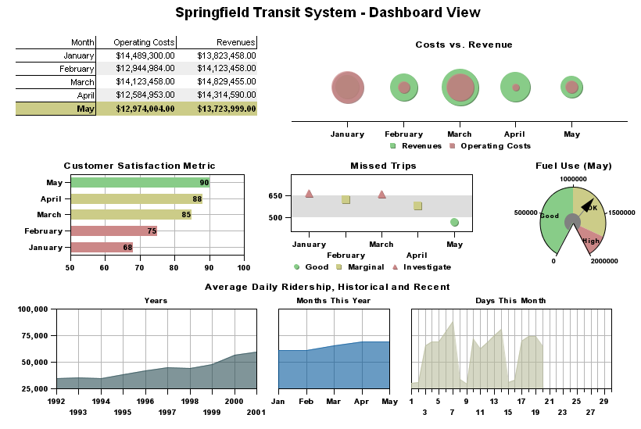
Technology Toolbox: Designing an EIS
http://www.visualmining.com

Slide 63
Cases: Autos

